Slide 1
Decreasing Employee Attrition: One Prediction At A Time
By: Emily Phillips

Slide 2
Introduction to the Business Problem(s)

Slide 3
What is Employee Attrition?
Definition : “When an employee leaves the company through any method, including voluntary resignations, layoffs, failure to return from a leave of absence, or even illness or death”
Two types of employee attrition:
Voluntary
Employee deliberately chooses to leave their company
Company has the decision to not replace the employee
Involuntary
The company chooses to let go of (fire) an employee
EX) Reorganization, layoffs
In this case, the company either eliminates the employee’s position altogether or chooses not to replace it
https://www.digitalhrtech.com/employee-attrition/

Slide 4
Issues with Voluntary Employee Attrition
Lack of continuity and consistency within organization and within teams
Training gaps
Lack of institutional knowledge
Higher recruiting efforts, longer recruiting time
Empty positions can be left for some time; leaves teams understaffed
Possible burnout for remaining employees -- overloaded and overworked
Increase in recruiting, hiring and training costs

Slide 5
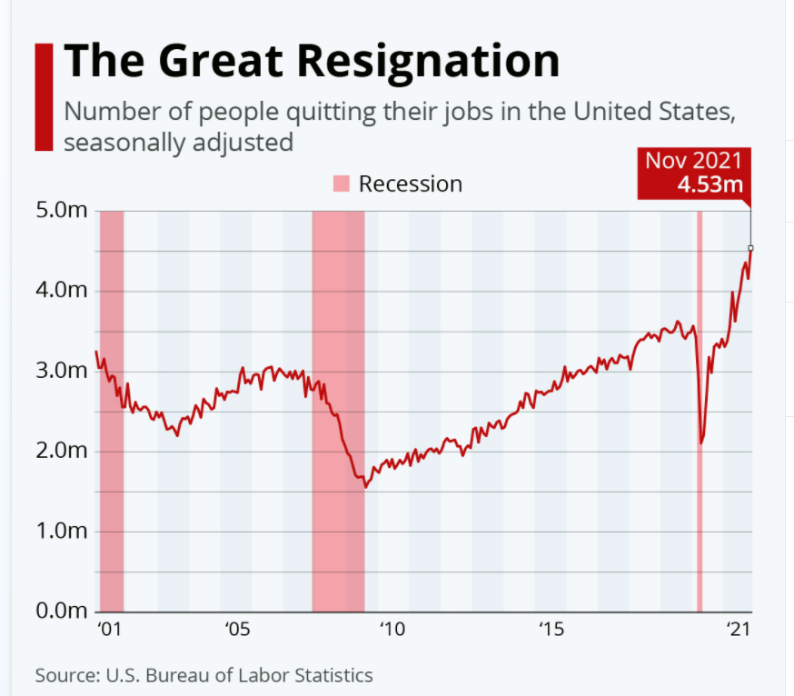
The United States is at an all-time high for number of people quitting their jobs!
Great Resignation Statistics

Slide 6
Statistical Question(s): What factors play a significant role in voluntary employee attrition, and how can we predict it?

Slide 7
Dataset Explanation

Slide 8
The Dataset: IBM HR Analytics Employee Attrition & Performance
Employee survey from IBM, a technology corporation
Gathered information around employee satisfaction, income, job level and some personal demographic data such as age and gender
Dataset structure:
1470 rows of data
35 columns
Each record in the dataset pertains to an employee that is either currently at IBM or voluntarily left
Attrition = ‘Yes’ or ‘No’
https://www.kaggle.com/pavansubhasht/ibm-hr-analytics-attrition-dataset

Slide 9
Key Factors in Employee Attrition
New survey by consulting firm McKinsey & Company released on March 9, 2022
Surveyed nearly 600 employees between December 2020 and December 2021
The Great Resignation was at a peak in November 2021
Found four top factors contributing to this historical event:
Unsustainable workloads
Uncaring managers
Inadequate compensation
Lack of career advancement potential
“About 35% of respondents said unsustainable work performance expectations were the reason they left a job without another in hand”
https://www.forbes.com/sites/emmylucas/2022/03/09/employees-say-unsustainable-workloads-and-expectations-are-driving-them-to-quit/?sh=5880b2d57c34

Slide 10
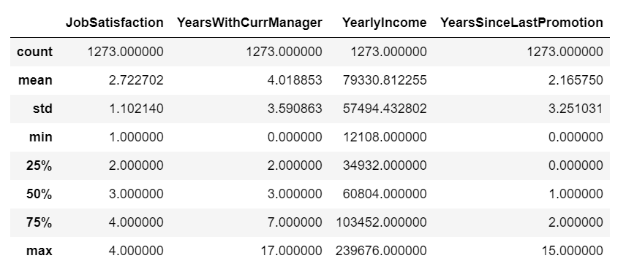
Description of Aligning Factors from the Kaggle Dataset

Slide 11
Data Visualizations – Exploration with Target Variable ‘Attrition’

Slide 12
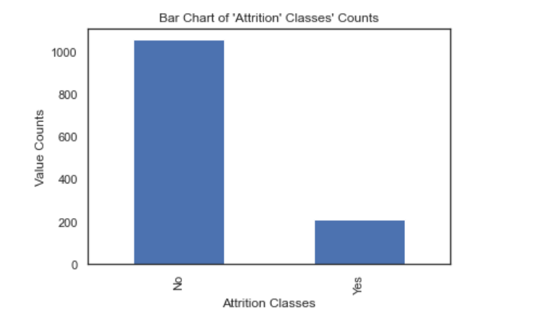
Target Variable – Class Distribution
Major imbalance between the two classes of ‘Yes’ & ‘No’
‘No’: 1,059 values
‘Yes’: 214 values
CHALLENGE: Need to handle class imbalance before performing predictive modeling

Slide 13
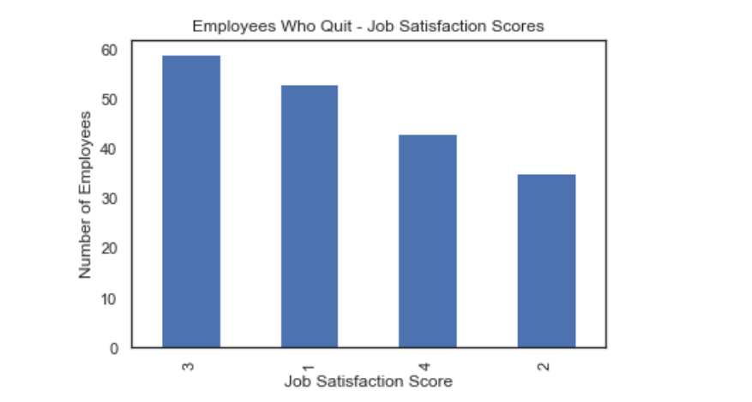
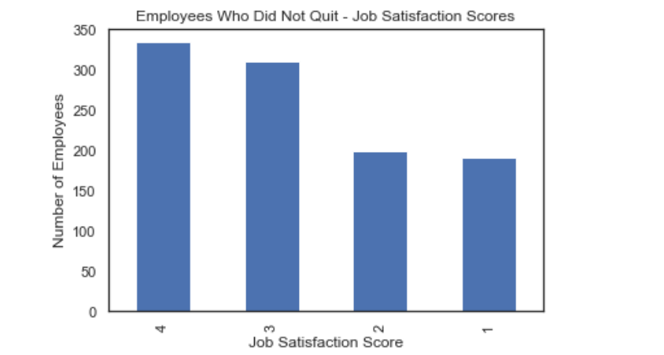
Bar Charts of Job Satisfaction Scores

Slide 14
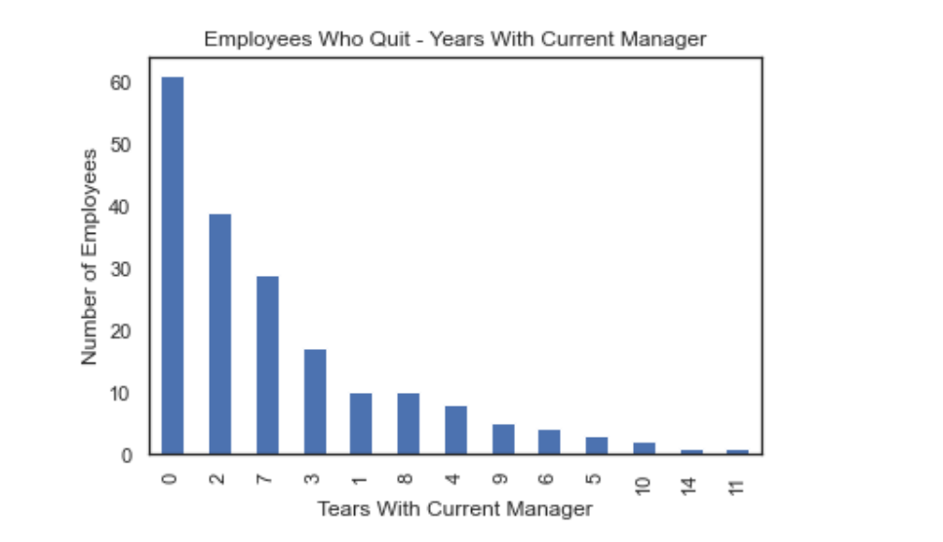
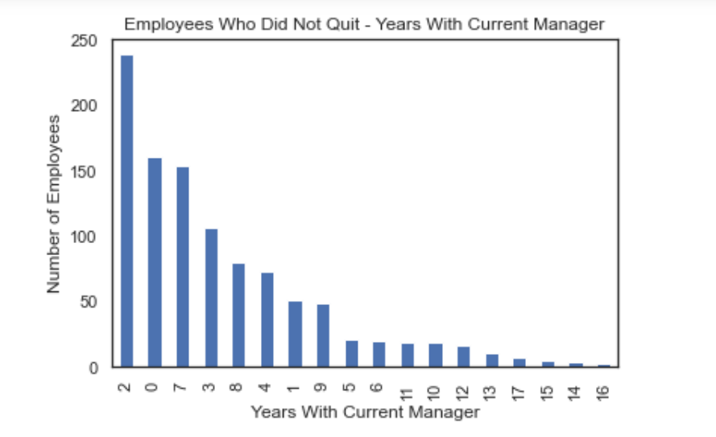
Bar Charts of Years With Current Manager

Slide 15
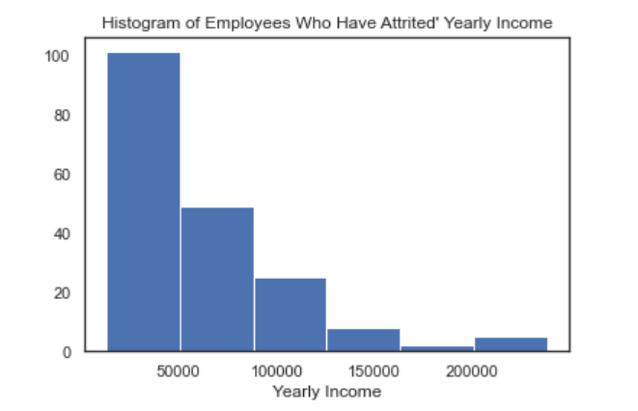
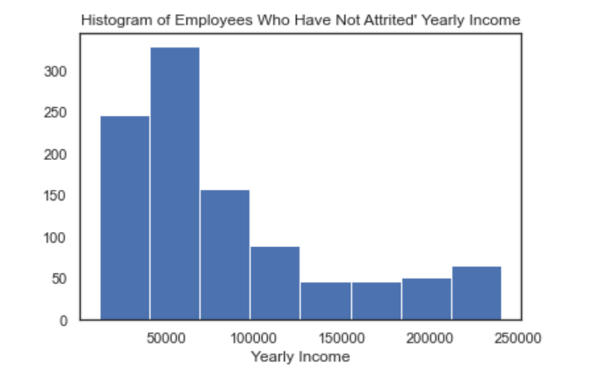
Histograms of Yearly Income (Salary)

Slide 16
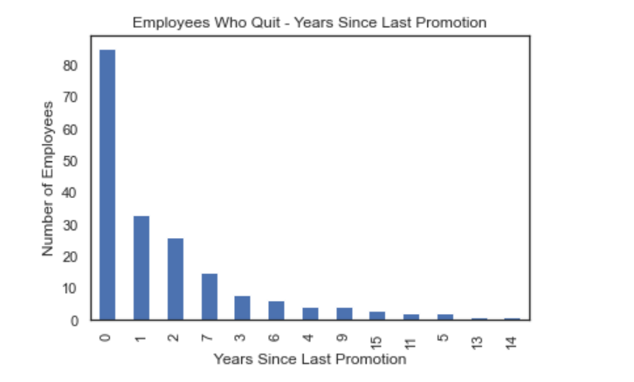
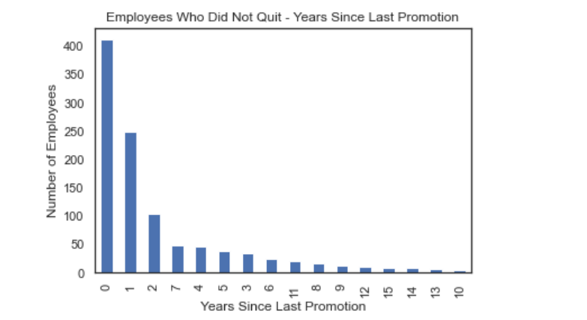
Bar Charts of Years Since Last Promotion

Slide 17
Predictive Modeling – Methods & Results

Slide 18
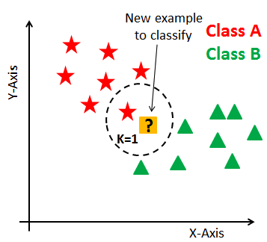
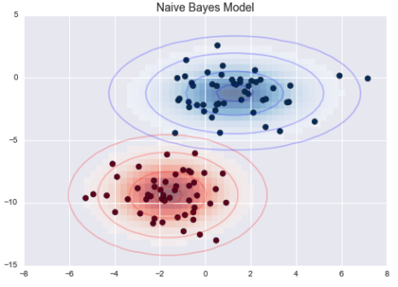
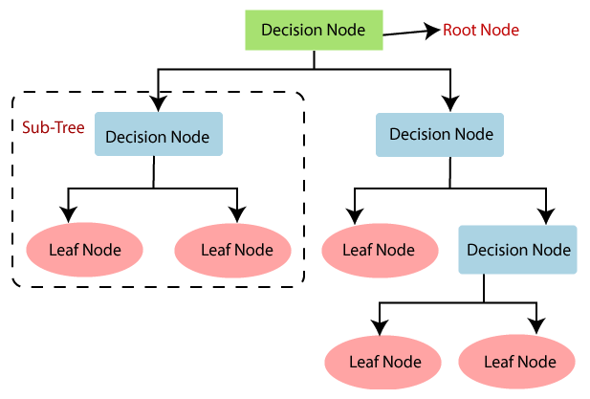
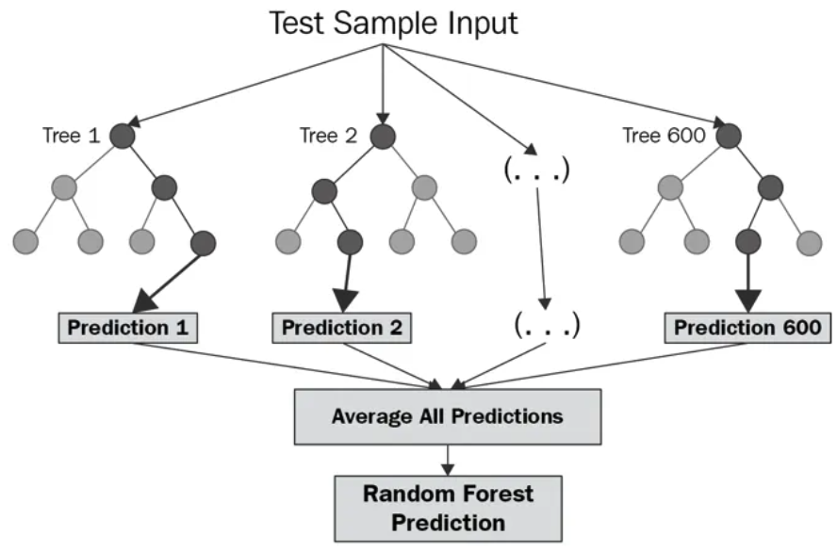
Modeling Deployment
Following my data preparation, I began to evaluate algorithms and methods to help use on the prediction problem. I focused on models appropriate for classification(predictor of ‘Yes’ or ‘No’).
K-Nearest Neighbor - Straight forward pattern recognition model which allows the testing of several k values and leaf sizes to determine the best performance
Decision Tree Classifier - A decision tree is a supervised learning algorithm that performs strong in classification problems
Naive Bayes - Calculates the possibility of whether a data point belongs within a certain category
Random Forest Classifier - Expands beyond a decision tree by constructing multiple decision trees to remediate forcing a binary decision

Slide 19
Modeling Results
Three Sets of Models:
Twenty-one features (A)
Four features (B)
Job Satisfaction
Years With Current Manager
Yearly Income
Years Since Last Promotion
Two features (C)
Job Satisfaction
Yearly Income
Models were evaluated based on the following measures:
Accuracy
Precision
Recall
Confusion matrices were also generated for each model in each set of data
Best model differed among the sets
Random Forest – 84.5% accuracy, high precision and recall for ‘Yes’ class (58.3% and 16.7% respectively)
Naïve Bayes – 83.2% accuracy, Decision Tree Classifier has better precision and recall (64.3% and 21.4% respectively)
Naïve Bayes – 83.2% accuracy, Random Forest has overall best precision and recall (25% and 26.2% respectively)

Slide 20
Future Uses & Recommendations

Slide 21
Proactivity vs. Reactivity
Companies need to stay ahead of employee resignations!
Build models based on organization’s human resources data
Other techniques can be taken to gauge feature importance in order to better narrow down the features that are critical for accurate model predictions
Deploy them throughout departments, one at a time, to start testing models on employees
Gauge trends and design initiatives to check-in with employees on their workloads, job satisfaction, career goals, etc.
Suitable team sizes
Bi-weekly manager 1:1s
Awareness of job opportunities → within and outside of teams
Mental health days
Proactive plans can be rolled out in phases to ensure proper controls and management are in place for an ethical process

Slide 22
Conclusion and Q & A

Slide 23
1. Why were you interested in this business problem of employee attrition? 2. How did you account for the imbalance in the target classes? 3. How often do you think these models should be tested on employees? 4. Should the dataset consider outside-of-work features that can play into employee attrition such as mental health, changing career paths, etc.? 5. Is there a certain department of organizations that is experiencing higher attrition rates than others? 6. Why was employee job level not considered in the modeling, i.e. leadership positions vs. technical positions? Do you think this would make a difference? 7. Could you have employed other techniques for feature reduction? 8. Did you consider other forms of visualizations for the exploration data analysis (EDA)? 9. Would you suggest that companies be transparent around this work if they choose to implement it for employees? 10. How does predicting whether an employee will resign (Yes/No) compare with assigning them risk scores as also recommended?

